Slide 1
Ensuring Well-Being in Digital Space
Dr Smita N Deshpande
Professor of Psychiatry
St John's National Academy of Health Sciences, Bengaluru

Slide 2
THANK YOU
Dr Angel Rathanabai
NCERT ,
Online training series on ‘ Cyber Safety and Security’

Slide 3
“These days we have smartphones, smart cars, smartboards, smart everything, but consider this: if the technology is getting smarter, does that mean humans are getting dumber?” Rebecca McNutt

Slide 4
Ensuring Well-Being in Digital Space
Components of ‘health’
Ensure your wellbeing in digital space
Overcoming Risks of Digital Overuse

Slide 5
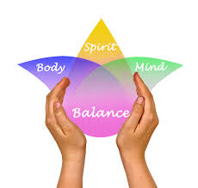
HEALTH
Health is a state of complete physical, mental and social well-being and not merely the absence of disease or infirmity (WHO 2001)
There is no health without mental health.
(WHO,1954)

Slide 6
Mental health
A state of well-being in which the individual
Realizes own abilities,
Can cope with the normal stresses of life,
Can work productively and fruitfully,
Can contribute to the community
(WHO 2001a, p.1)

Slide 7
Mental health is essential for the well-being and functioning of individuals, families, communities and nations. Mental health is determined by Individual factors and experiences, Social interaction, societal structures and resources Cultural values Mental, physical, and social functioning are interdependent.
Mental Health

Slide 8
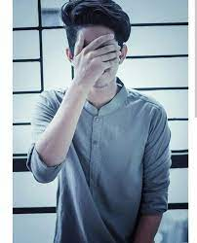
Who is mentally healthy?
Someone who is always online?
Who remains isolated because they feel no good at anything?
Are they mentally healthy?

Slide 9
Emotional health is part of mental health

Slide 10
Foster positive emotions
Happiness
Self-esteem, feeling of mastery over the environment
Resilience- the capacity to cope with adversity
Self-realization- being the best you can be
Exploit your own potential
Autonomy
Ability to identify, confront, and solve problems
Subjective sense of well-being

Slide 11
SOCIAL health is part of mental health

Slide 12
Social Health Is Part Of Mental Health
Sustain mutually satisfying and enduring social relationships.
Social cohesion
Social capital: networks, norms, and social trust
Social connectedness

Slide 13
Ensuring Well-Being in Digital Space
Physical
social
emotional
mental
HOLISTIC
Prevent physical ill effects
Prevent isolation
Prevent emotional abuse
Foster positive mental health
HEALTH

Slide 14
Prevent Physical Ill-Effects Of Digital Use
Ill effect
How to prevent
Inactive (Shut-in Lifestyle)
Weight gain
Meet people, increase activity levels
Obesity = disease, get moving!

Slide 15
Prevent Physical Ill-Effects Of Digital Use
Ill effect
How to prevent
Sleep disturbance
No digital use before bedtime
Adopt good sleep practices

Slide 16
Prevent Physical Ill-Effects Of Digital Use
Ill effect
How to prevent
Eye strain (Computer Vision Syndrome)
Hearing problems
Looking away – 20/20/20 rule
Screen at proper distance
Less earphone use

Slide 17
Prevent Physical Ill-Effects Of Digital Use
Ill effect
How to prevent
Muscles/joint strain, pain, stiffness
Good posture
Screen at proper distance
Stretch, relax your joints and muscles

Slide 18
Proper postures while working digitally

Slide 19
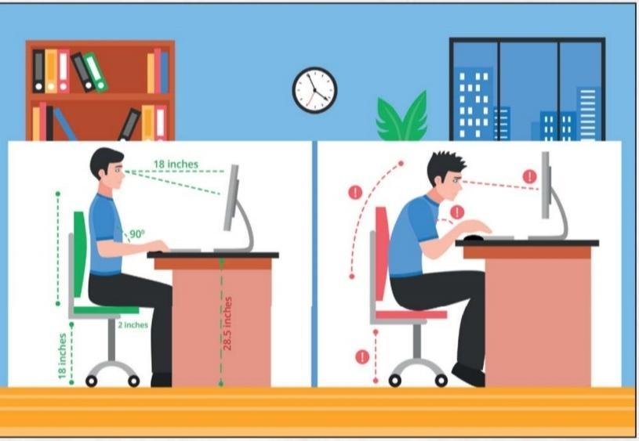

Slide 20
Lifestyle Changes
Engage in aerobic activities to improve heart functioning, feel good and strengthen immune response.
Walk, jog or run regularly
Engage in sport
Regular Yoga
During daily activities, try to move more e.g stretching, standing, bending

Slide 21
desk exercises while using digital devices
Neck rotation
Shoulder rotation
Shoulder blade retraction
Shrug
Wrist rotation
Stretch up
Finger fan
Toe curl

Slide 22
Ensuring Well-Being in Digital Space
Physical
social
emotional
mental
HOLISTIC
Prevent physical ill effects
Prevent isolation
Prevent emotional abuse
Foster positive mental health
HEALTH

Slide 23
Control Digital Use
Reduce the number of apps to only essential ones
Turn off notifications
Don’t sleep with your phone next to your bed
Recognize triggers of phone use
Set goals for when you can use your smartphone
Turn off your phone at certain times of the day

Slide 24
Ensuring Well-Being in Digital Space
Physical
social
emotional
mental
HOLISTIC
Prevent physical ill effects
Prevent isolation
Prevent emotional abuse
Foster positive mental health
HEALTH

Slide 25
Use Digital Spaces Safely
Know the risks of internet use
Set appropriate privacy settings.
Do not share personal information, like phone number, email or home address, school/ college details, or photographs with unknown persons.
Do not install software, applications, games, etc. from unknown sources.

Slide 26
Use Digital Spaces Safely
Know the risks of internet use
Do not freely share photographs or videos online.
Do not turn on the webcam while talking to unknown people.
Do not share or circulate hurtful/embarrassing comments, videos, or photographs on online platforms.
Do not share unverified news/ information/ messages.

Slide 27
Ensuring Well-Being in Digital Space
Physical
social
emotional
mental
HOLISTIC
Prevent physical ill effects
Prevent isolation
Prevent emotional abuse
Foster positive mental health
HEALTH

Slide 28
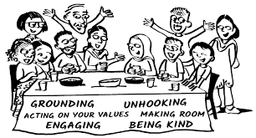
Develop strategies to improve well-being
Education: Acquire information to manage mental health challenges.
Reframing: review a situation to reduce its emotional impact.
Grounding: Use sensory techniques to stay connected to the present
Relaxation: to reduce stress and promote a sense of calm and well-being.
WHO,2020

Slide 29
Develop strategies to improve well-being
Build Social Support: Strengthen connections and offer / seek assistance from friends, family, or a support network.
Problem-Solving: Systematically identify, analyse and find solutions to challenges or issues.
WHO,2020

Slide 30
Ensuring Well-Being in Digital Space
Physical
social
emotional
mental
HOLISTIC
Prevent physical ill effects
Prevent isolation
Prevent emotional abuse
Foster positive mental health
HEALTH

Slide 31
Use The Internet For Positive Health
Use the net for
Collaborating,
Developing new skills;
Fostering creativity, self-expression, out-of-the-box thinking,
Problem-solving,
Accessing new information,
Alternative opinions and options to reduce burden, improve efficiency and efficacy;
Explore fields one is passionate about

Slide 32
Use The Internet For Positive Health
Use good physical and mental health groups/sites
Sites for health promotion & Mental health interventions
Increase social connectivity, broaden social relationships
Entertainment

Slide 33
Adopt different practical coping skills
Understand difference between interacting in-person and online
Behave online as in real life
Use social media responsibly
Develop digital resilience
Build coping skills
Strengthen support network
Develop proactive coping strategies:
Block unwanted contacts,
Do NOT share private information online,
Develop digital safeguards

Slide 34
Standard operating procedures to tackle a digital crisis
Inform social network: friends, family, elders, teachers, or a trusted adult.
Disable geolocation and GPS settings.
Set up appropriate privacy settings.
Gather information and document evidence such as saving messages, threatening material, screenshots, call recordings, etc.
Stop communication. In case of cyber harassment, do not respond to the criminal/ perpetrator. Always unfriend/ unfollow/ block individuals that make you feel unsafe in your digital space.
Report the incident to the concerned authorities.

Slide 35
When to Consult an Expert
When a person:
Withdraws from people and things,
Spends excessive time online,
Low or no energy, unexplained aches and pains, changes on sleeping or eating habits.
Feelings of helplessness or hopelessness, difficulty in concentrating,
Aggressive behaviours,
Drop in academic or work performance;
Frequent conflicts with friends and family,
High-risk behaviors such as smoking, drinking, drug misuse or abuse;
Harm others and/or self, suicidal ideations and/ or attempts/ behaviours

Slide 36
THANK YOU

